Slide 1
Introduction : Ordinary Differential Equations
ISHWOR KHATIWADA

Slide 2
Ordinary Differential Equations
Where do ODEs arise?
Notation and Definitions
Solution methods for 1st order ODEs

Slide 3
Where do ODE’s arise
All branches of Engineering
Economics
Biology and Medicine
Chemistry, Physics etc
Anytime you wish to find out how something changes with time (and sometimes space)

Slide 4

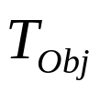

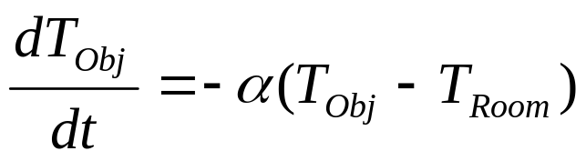
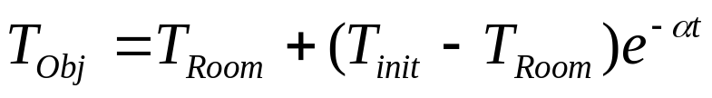

Example – Newton’s Law of Cooling
This is a model of how the temperature of an object changes as it loses heat to the surrounding atmosphere:
Temperature of the object:
Room Temperature:
Newton’s laws states: “The rate of change in the temperature of an object is proportional to the difference in temperature between the object and the room temperature”
Form ODE
Solve
ODE
Where is the initial temperature of the object.

Slide 5

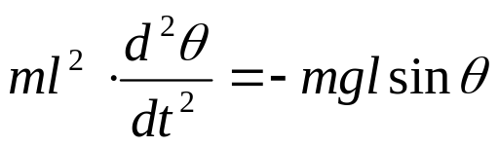
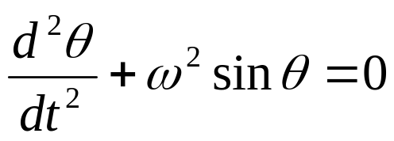
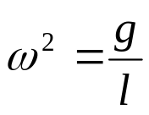
Example – Swinging of a pendulum
Newton’s 2nd law for a rotating object:
Moment of inertia x angular acceleration = Net external torque
θ
rearrange and divide through by ml ²
l
where
mg
This equation is very difficult to solve.

Slide 6
Notation and Definitions
Order
Degree
Linearity
Homogeneity
Initial Value/Boundary value problems

Slide 7
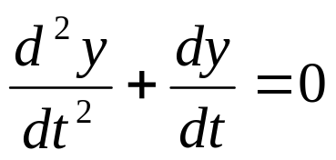
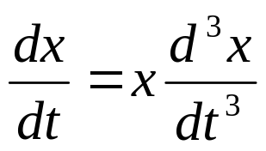
Order
The order of a differential equation is just the order of highest derivative used.
.
2nd order
3rd order

Slide 8
Degree of an ODE
The degree of the highest derivative of y in the equation is called the degree of the ODE.

Slide 9
Types of equations first order and first degree
Variable separable equations
Homogeneous equations
Exact equations
Linear equations

Slide 10
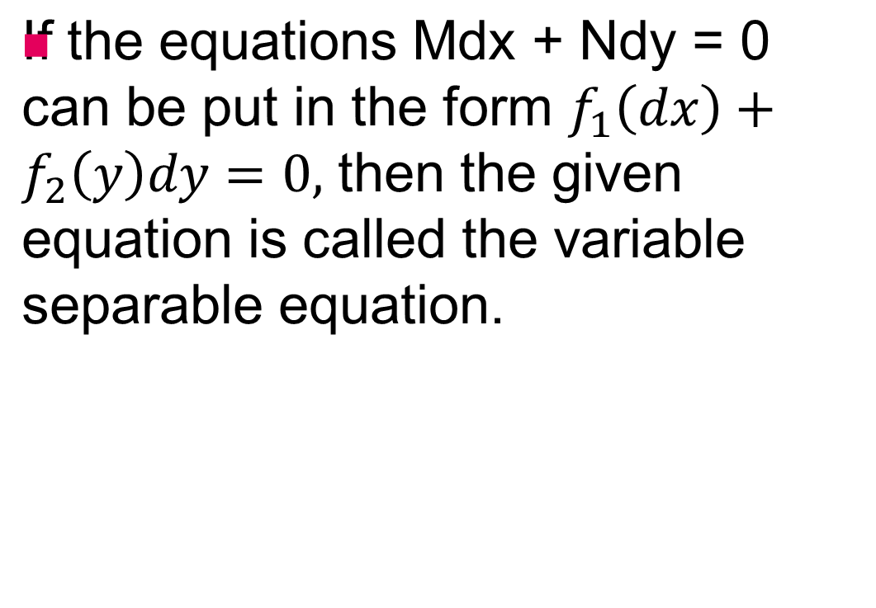
Variable Separable Equations

Slide 11
Linearity
The important issue is how the unknown y appears in the equation. A linear equation involves the dependent variable (y) and its derivatives by themselves. There must be no "unusual" nonlinear functions of y or its derivatives.
A linear equation must have constant coefficients, or coefficients which depend on the independent variable (t). If y or its derivatives appear in the coefficient the equation is non-linear.

Slide 12
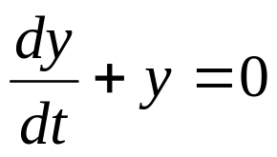
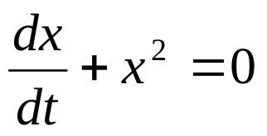
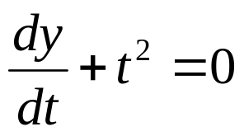
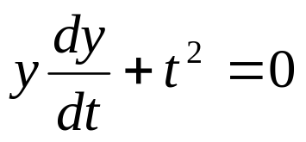
Linearity - Examples
is linear
is non-linear
is linear
is non-linear

Slide 13




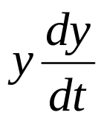


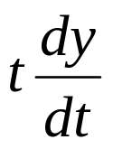
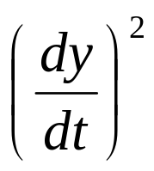
Linearity – Summary
Linear | Non-linear
or

Slide 14



Linearity – Special Property
If a linear homogeneous ODE has solutions:
and
then:
where a and b are constants,
is also a solution.

Slide 15
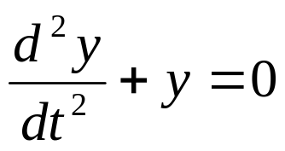


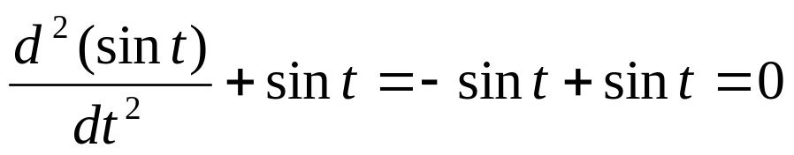
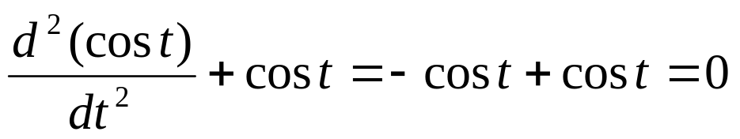

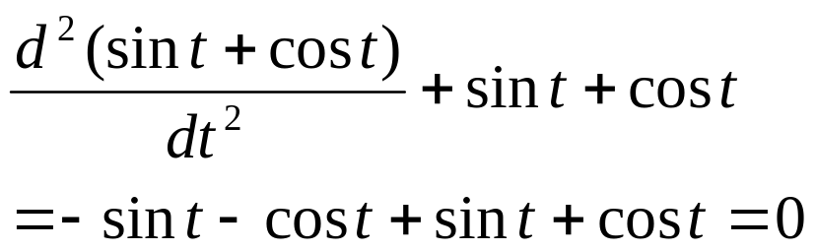
Linearity – Special Property
Example:
has solutions
and
Check
Therefore
is also a solution:
Check

Slide 16
Life is mostly linear!!!
Most ODEs that arise in engineering are linear with constant coefficients.
In many cases they are approximate versions of more complex nonlinear models but they are sufficiently accurate for most purposes. Often they work OK for small amplitude disturbances but for large amplitude behaviour nonlinearities start to have some effect.
For linear systems the qualitative behaviour is independent of amplitude.
The coefficients in the ODE correspond to system parameters and are usually constant.
Sometimes nonlinearities are important and there have been some important failures because nonlinearities were not understood e.g. the collapse of the Tacoma Narrows bridge.

Slide 17
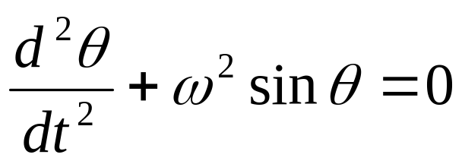
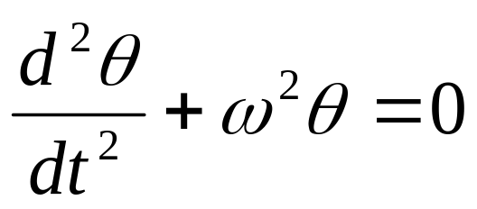
Approximately Linear – Swinging pendulum example
The accurate non-linear equation for a swinging pendulum is:
But for small angles of swing this can be approximated by the linear ODE:

Slide 18
Homogeniety
Put all the terms of the equation which involve the dependent variable on the LHS.
Homogeneous: If there is nothing left on the RHS the equation is homogeneous (unforced or free)
Nonhomogeneous: If there are terms involving t (or constants) - but not y - left on the RHS the equation is nonhomogeneous (forced)

Slide 19
Initial Value/Boundary value problems
Problems that involve time are represented by an ODE together with initial values.
Problems that involve space (just one dimension) are also governed by an ODE but what is happening at the ends of the region of interest has to be specified as well by boundary conditions.

Slide 20
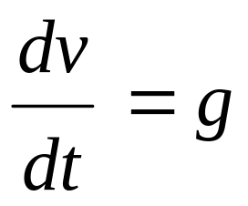
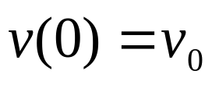
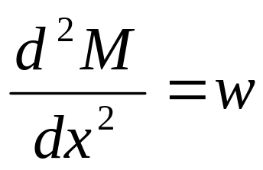
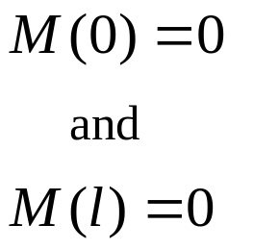
Example
1st order
Linear
Nonhomogeneous
Initial value problem
2nd order
Linear
Nonhomogeneous
Boundary value problem

Slide 21

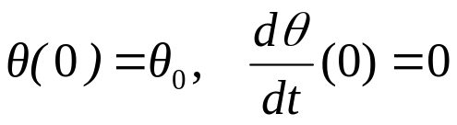

Example
2nd order
Nonlinear
Homogeneous
Initial value problem
2nd order
Linear
Homogeneous
Initial value problem

Slide 22
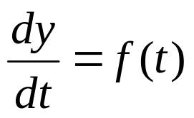
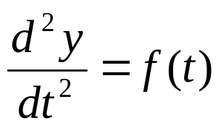


Solution Methods - Direct Integration
This method works for equations where the RHS does not depend on the unknown:
The general form is:

Slide 23
Direct Integration
y is called the unknown or dependent variable;
t is called the independent variable;
“solving” means finding a formula for y as a function of t;
Mostly we use t for time as the independent variable but in some cases we use x for distance.

Slide 24
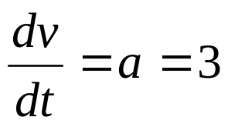

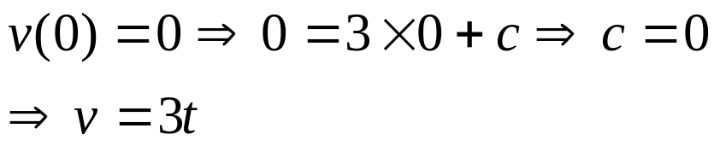
Direct Integration – Example
Find the velocity of a car that is accelerating from rest at 3 ms⁻²:
If the car was initially at rest we have the condition:

Slide 25
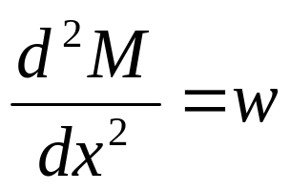

Bending of a beam - Example
A beam under uniform load
Beam theory gives the governing equation:
with boundary conditions:
(pinned ends)

Slide 26
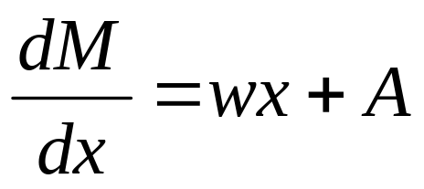
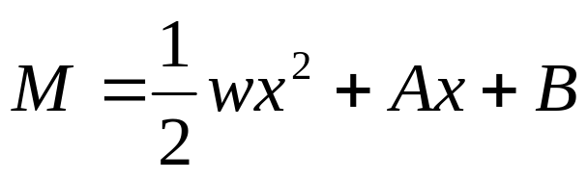
Bending of a beam - Solution
Step 1:
Integrate
Step 2:
Integrate again to obtain the general solution:

Slide 27

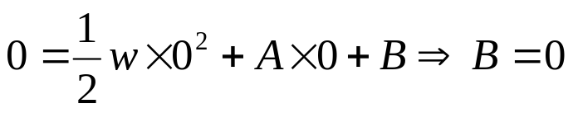

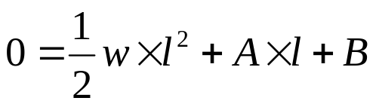
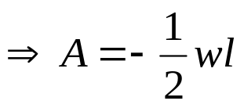
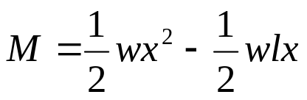
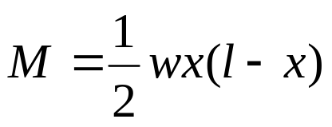
Bending of a beam - Solution
Step 3:
Use the boundary conditions to obtain the particular solution.
Step 4:
Substitute back the values for A and B

Slide 28
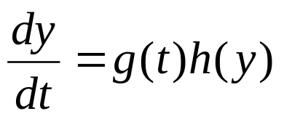
Solution Methods - Separation
The separation method applies only to 1st order ODEs. It can be used if the RHS can be factored into a function of t multiplied by a function of y:

Slide 29
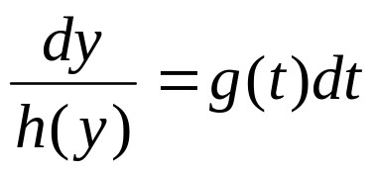
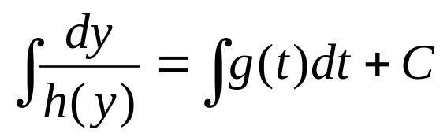
Separation – General Idea
First Separate:
Then integrate LHS with respect to y, RHS with respect to t.

Slide 30
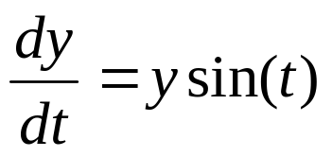
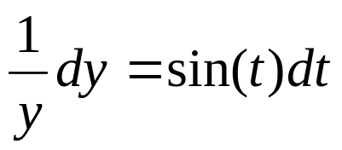
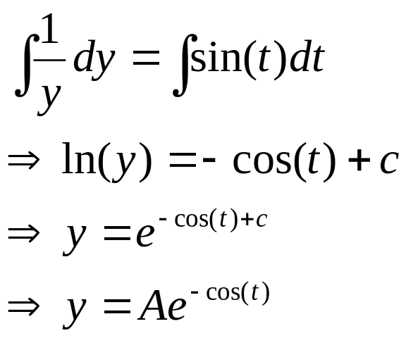
Separation - Example
Separate:
Now integrate:

Slide 31
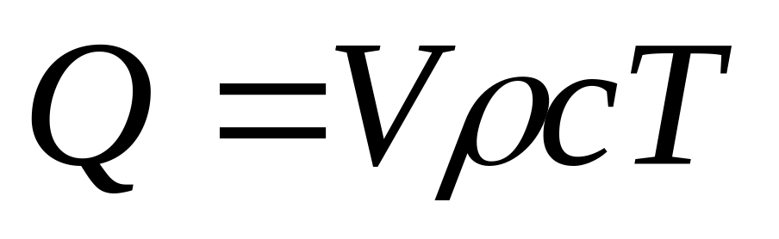
Cooling of a cup of coffee
Amount of heat in a cup of coffee:
heat
volume
specific heat
density
temperature
Heat balance equation (words):
Rate of change of heat = heat lost to surrounding air

Slide 32
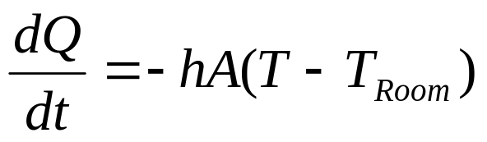
Cooling of a cup of coffee
Newton’s law of cooling:
Heat lost to the surrounding air is proportional to temperature difference between the object and the air
The proportionality constant involves the surface area multiplied by a heat tranfer coefficient
Heat balance equation (maths) :

Slide 33
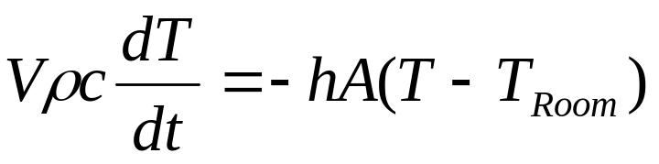
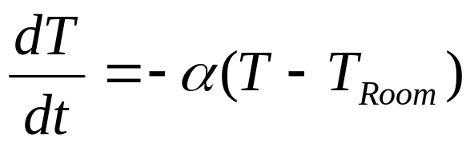
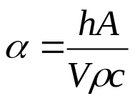

Cooling of a cup of coffee
Substitute in
rearrange
where
Now we solve the equation together with the initial condition:

Slide 34





Cooling of a cup of coffee - Solution
Step 1:
Separate
Step 2:
Integrate
Make explicit in unknown T
where

Slide 35



Cooling of a cup of coffee - Solution
Step 3:
Use Initial Condition
Step 4:
Substitute back to obtain final answer

Slide 36
Solution Methods - Integrating Factor
The integrating factor method is used for nonhomogeneous linear 1st order equations
The basic ideas are:
Collect all the terms involving y and on the left hand side of the equation.
Combine them together as the derivative of a single function of y and t.
Solve by direct integration.
The cunning trick is that step 2 cannot usually be done unless you first multiply the whole equation by an integrating factor.

Slide 37


Integrating Factor – Example
There are several ways to solve this problem but we will use it to demonstrate the integrating factor method. To understand the integrating factor method you must be very familiar with the formula for the derivative of a product:

Slide 38

Integrating Factor – Example
Product Rule:
The basic idea is that if we multiply the ODE by the correct function (an integrating factor) we can make the LHS of the ODE look like the RHS of the product rule.

Slide 39



Integrating Factor – Example
We will look ahead, use the answer and show how it is derived later. For our ODE the integrating factor is
Thus the ODE becomes:
Now the LHS of this equation looks like the RHS of the Product Rule with:

Slide 40



Integrating Factor – Example
We can rewrite the equation as:
or
Now we can use direct integration
Do not forget C, the constant of integration!

Slide 41



Integrating Factor – Example
Rearrange to make this explicit in y
Now use the initial condition to calculate C
Substitute back to obtain the final solution

Slide 42


How do we calculate the integrating factor?
Let us now pretend we do not know what the integrating factor should be
Call it Φ and use it to multiply the ODE from the previous example
To make the LHS of this equation look like the RHS of the Product Rule we must choose

Slide 43


How do we calculate the integrating factor?
Then the ODE becomes
Now using the product rule in reverse the LHS can be written as a single term (a very clever trick)

Slide 44


How do we calculate the integrating factor?
Now we can integrate once we know Φ
We can separate to find Φ
The convention is to put A = 1. It appears in every term of the ODE, and therefore can be divided out. This gives the integrating factor:

Slide 45


Finding the integrating factor in general
Given the general form of a nonhomogeneous 1st order equation:
How do we use the integrating factor method to find a y?

Slide 46



Finding the integrating factor in general
Step 1: Multiply by Φ:
Step 2: Compare with the RHS of the Product Rule and set up equation for Φ:
Step 3: Use separation to solve for Φ:

Slide 47



Finding the integrating factor in general
Step 4: Combine terms on the LHS:
Step 5: Integrate:
Step 6: Divide by to make explicit in y :
Step 7: Use the initial conditions to evaluate C :

Slide 48



Finding the integrating factor in general
Notes:
After you have been through the process a few times then skip some of the steps. For example you can remember the formula for the integrating factor, you do not have to re-derive it every time.
In principle this process can be used to solve any linear nonhomogeneous 1st order ODE but some of the details may be tricky or impossible. Both the integrals
and
may be impossible to evaluate.

Slide 49



Solving an example using the integrating factor method
Step 1: Put the ODE into the general form:
The ODE is already in that form!
Step 2: Find the integrating factor:

Slide 50



Solving an example using the integrating factor method
Step 3: Multiply by the integrating factor:
Step 4: Use the reverse Product Rule:
Step 5: Integrate and make explicit in y:

Slide 51


Solving an example using the integrating factor method
Step 6: Use the initial conditions to find the exact solution:
Step 7: Substitute back into the original equation:

Slide 52

Exponential substitution
The exponential trial or guessing method can be used for solving linear constant coefficient homogeneous differential equations.
The basic trial for the solution of the ODE is:

Slide 53



Characteristic Equations
gives the differentials
An algebraic characteristic equation comes from substituting in for y and its derivatives and cancelling out

Slide 54






Exponential Trial - Example
Try
Cancelling out gives the characteristic equation
Substituting this back into gives

Slide 55


Solving Guide
General Form | Description | Solving Method
1st or higher order
RHS does not depend on the unknown y
Direct Integration
1st order only
Separation
1st order
nonhomogeneous
linear equation
Integrating Factor Method

Slide 56


Solving Guide
General Form | Description | Solving Method
2nd order or higher
homogeneous
linear equation
constant coefficients
Exponential trial. See Module 2
2nd order or higher
nonhomogeneous
linear equation
constant coefficients
Problems like this can be solved for some types of f.
Covered in Modules 3 and 5

Slide 57


Solving Guide
General Form | Description | Solving Method
2nd order or higher
nonhomogeneous
linear equation
variable coefficients
Can only solve a few ‘special’ problems
Not Covered in MM2
2nd order
Function f contains t, y and y’ terms all mixed up
Generally can’t be solved analytically
(see Module 4 for numerical methods)

